Slide 1

Handwritten Digit Recognition using CNN
Presented by –Supriya rath

Slide 2
INTRODUCTION
What is Handwritten Digit Recognition?
  Handwritten Digit Recognition is a computer vision task where a machine identifies numerical digits (0–9) written by humans.
  It is widely used in postal mail sorting, bank cheque verification, form reading, and OCR systems.
Why CNN?
  CNN detects edges , patterns, and shapes from images.
  CNN automatically reduces computation using pooling layers.
  CNN gives very high accuracy on images datasets like MNIST

Slide 3
MNIST Dataset Details
About MNIST Dataset
  MNIST = Modified National Instituteof Standards and Technology.
  Contains 70,000 handwritten digit images.
  60,000 training AND 10,000 test
  Each image: 28 × 28 pixels, grayscale, digit centered
  Dataset is already pre-labeled (0–9), making it ideal for training supervised models.
Why MNIST is Important
Simple and widely used benchmark dataset.
Helps beginners understand image classification
CNN models reach 98–99% accuracy easily.

Slide 4
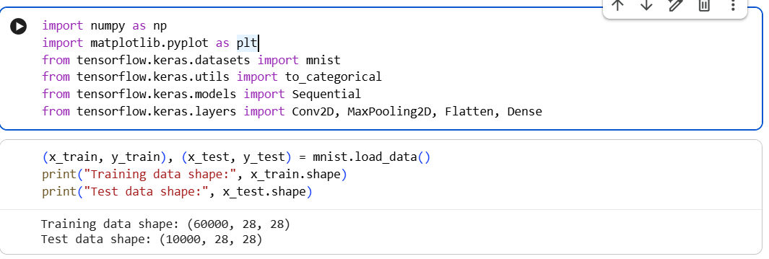
The Power of Communication
CNN Architecture
Uses Conv, ReLU, Pooling, Fully Connected layers
Learns edges, patterns, shapes
Ideal for image tasks like MNIST

Slide 5
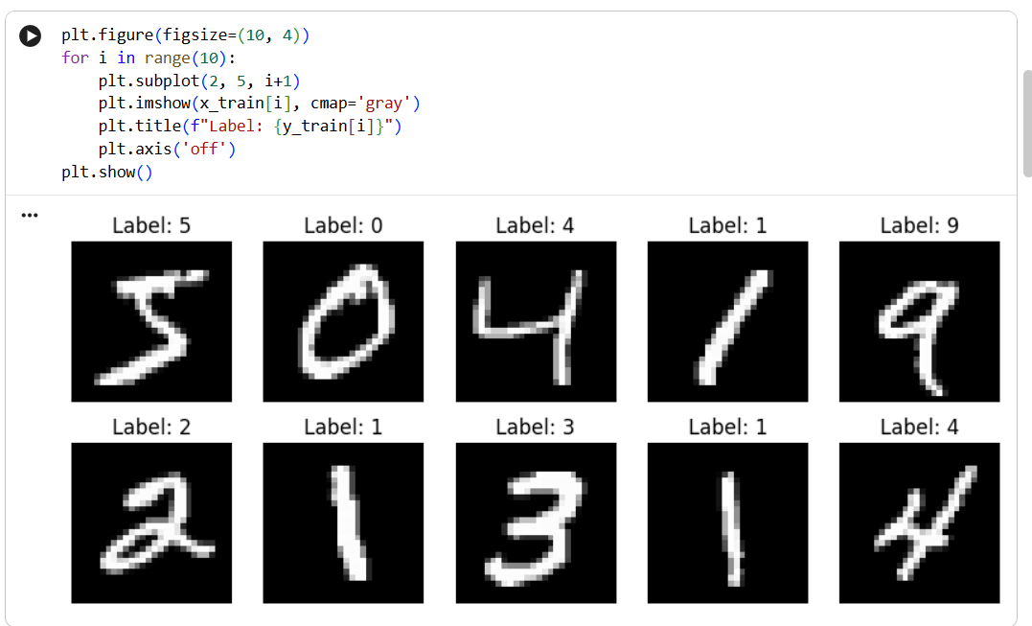
Data Preprocessing
Normalize images (0–1)
Reshape to 28×28×1
One-hot encode labels
MNIST split: 60k train, 10k test

Slide 6
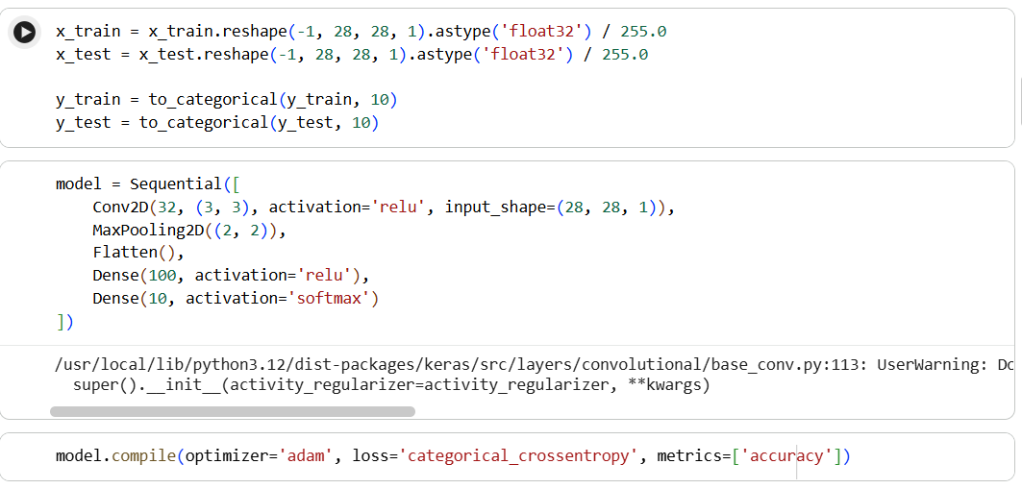
The Power of Communication
Training the Model
Loss: Categorical Crossentropy
Optimizer: Adam
Trained for several epochs
Learns digit strokes + shapes

Slide 7
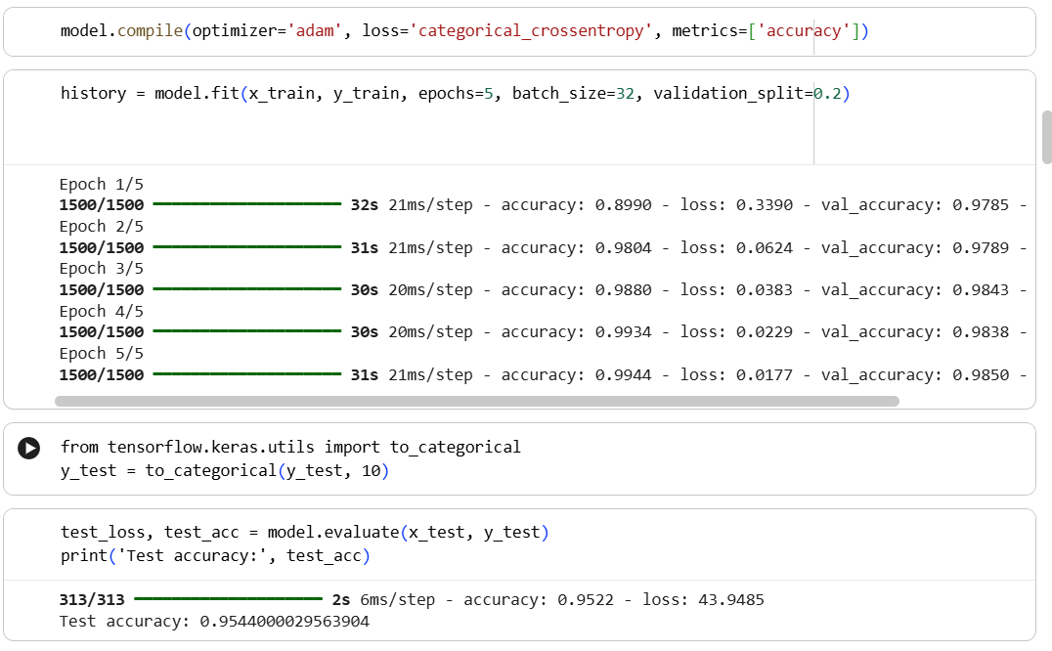
Evaluation
Tested on 10k images
Achieved ~95% accuracy
Confusion matrix shows similar
digits misclassified

Slide 8
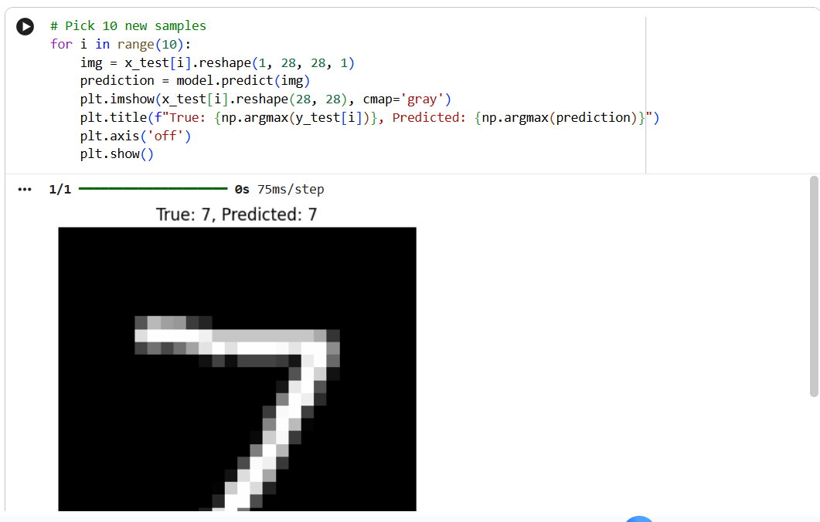
Predictions
Works on clear + tilted handwriting
Predicts digits reliably
Shows strong generalization

Slide 9
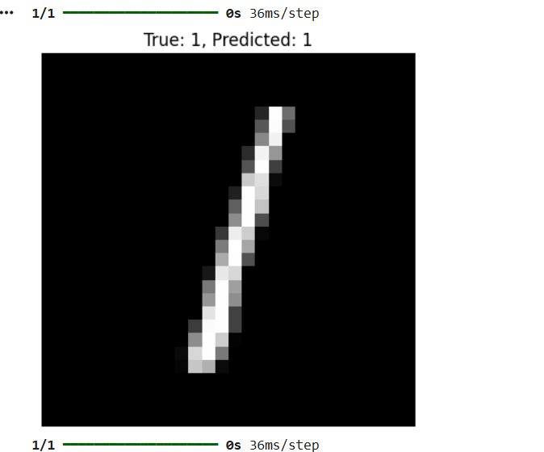
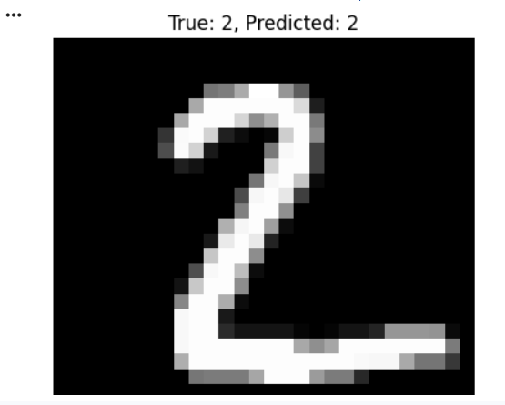
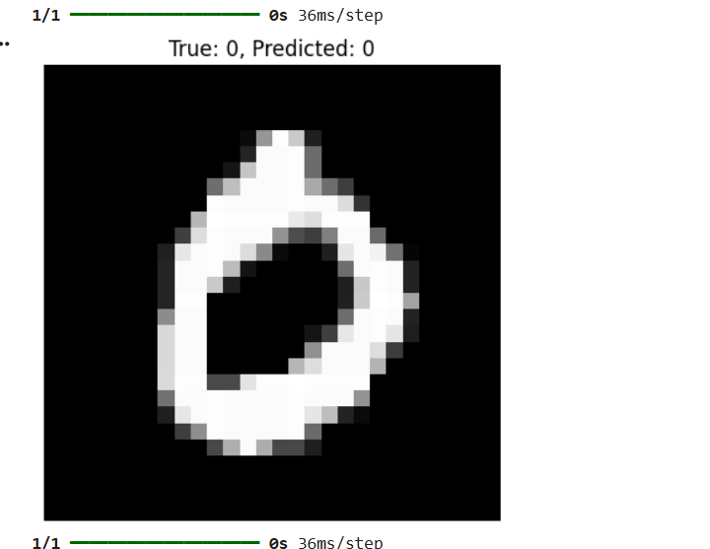
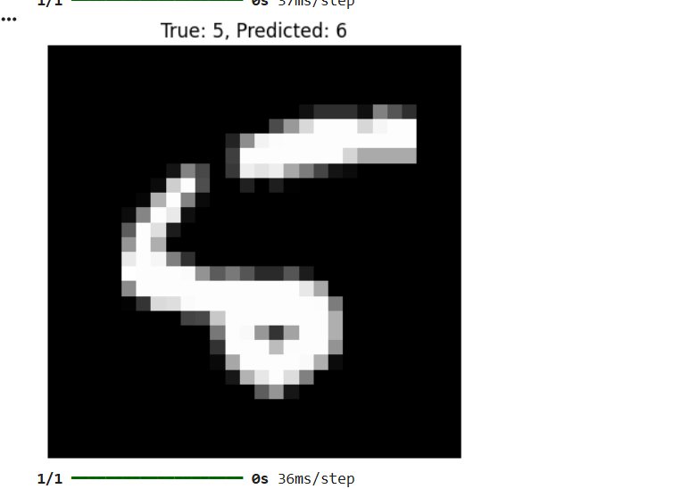
Applications
Bank cheque reading
Postal code sorting
OCR systems
Digital form processing
Handwriting input on devices

Slide 10

CONCLUSION
A CNN-based model was successfully built for handwritten digit recognition.
Achieved ~95% accuracy on test data.
The model can classify handwritten digits with high reliability.
MNIST dataset is ideal for beginners and demonstrates the power of CNNs in image classification tasks.

Slide 11
THANK YOU
Supriya rath
supriyarath424@gmail.com
supriya231003003220@technoindiaeducation.com

